Slide 1


Slide 2

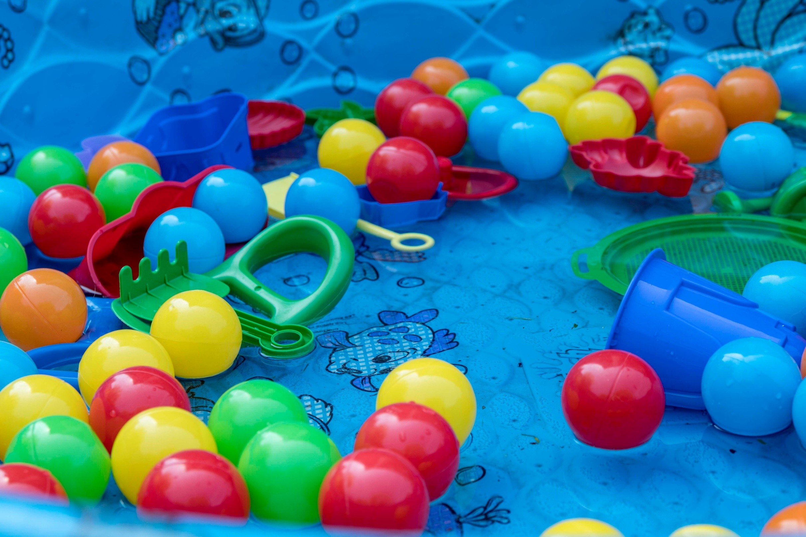

Slide 3
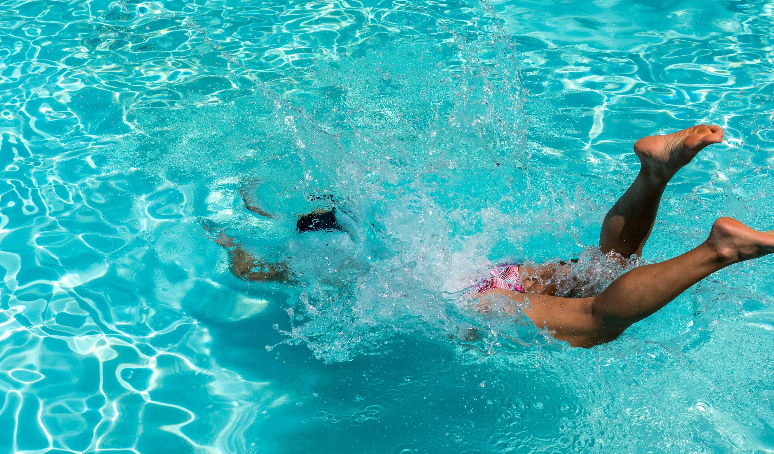

Slide 4
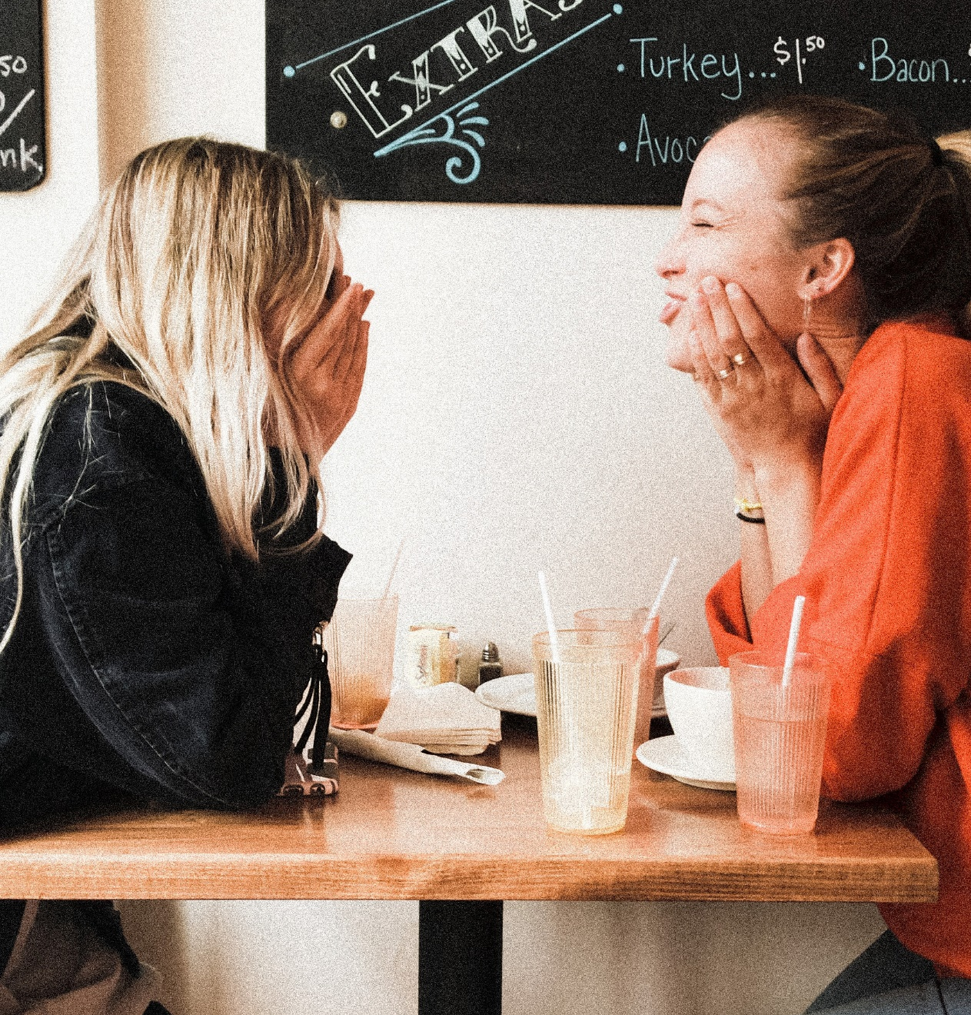
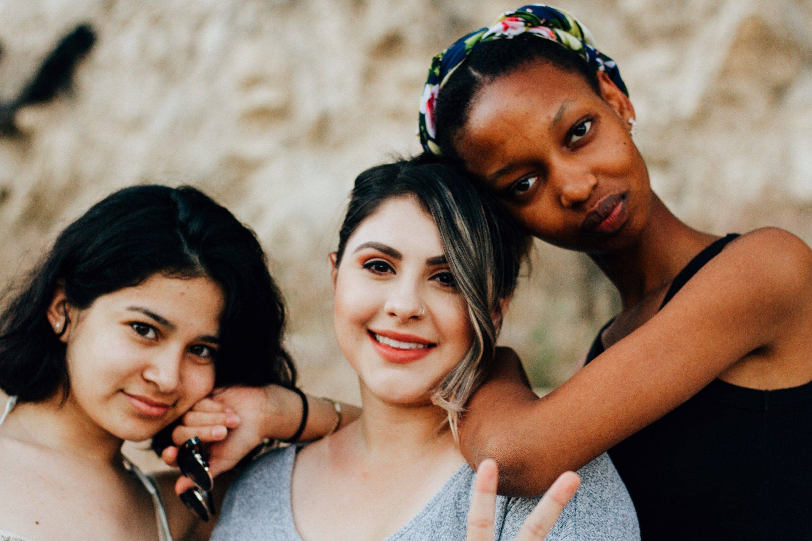
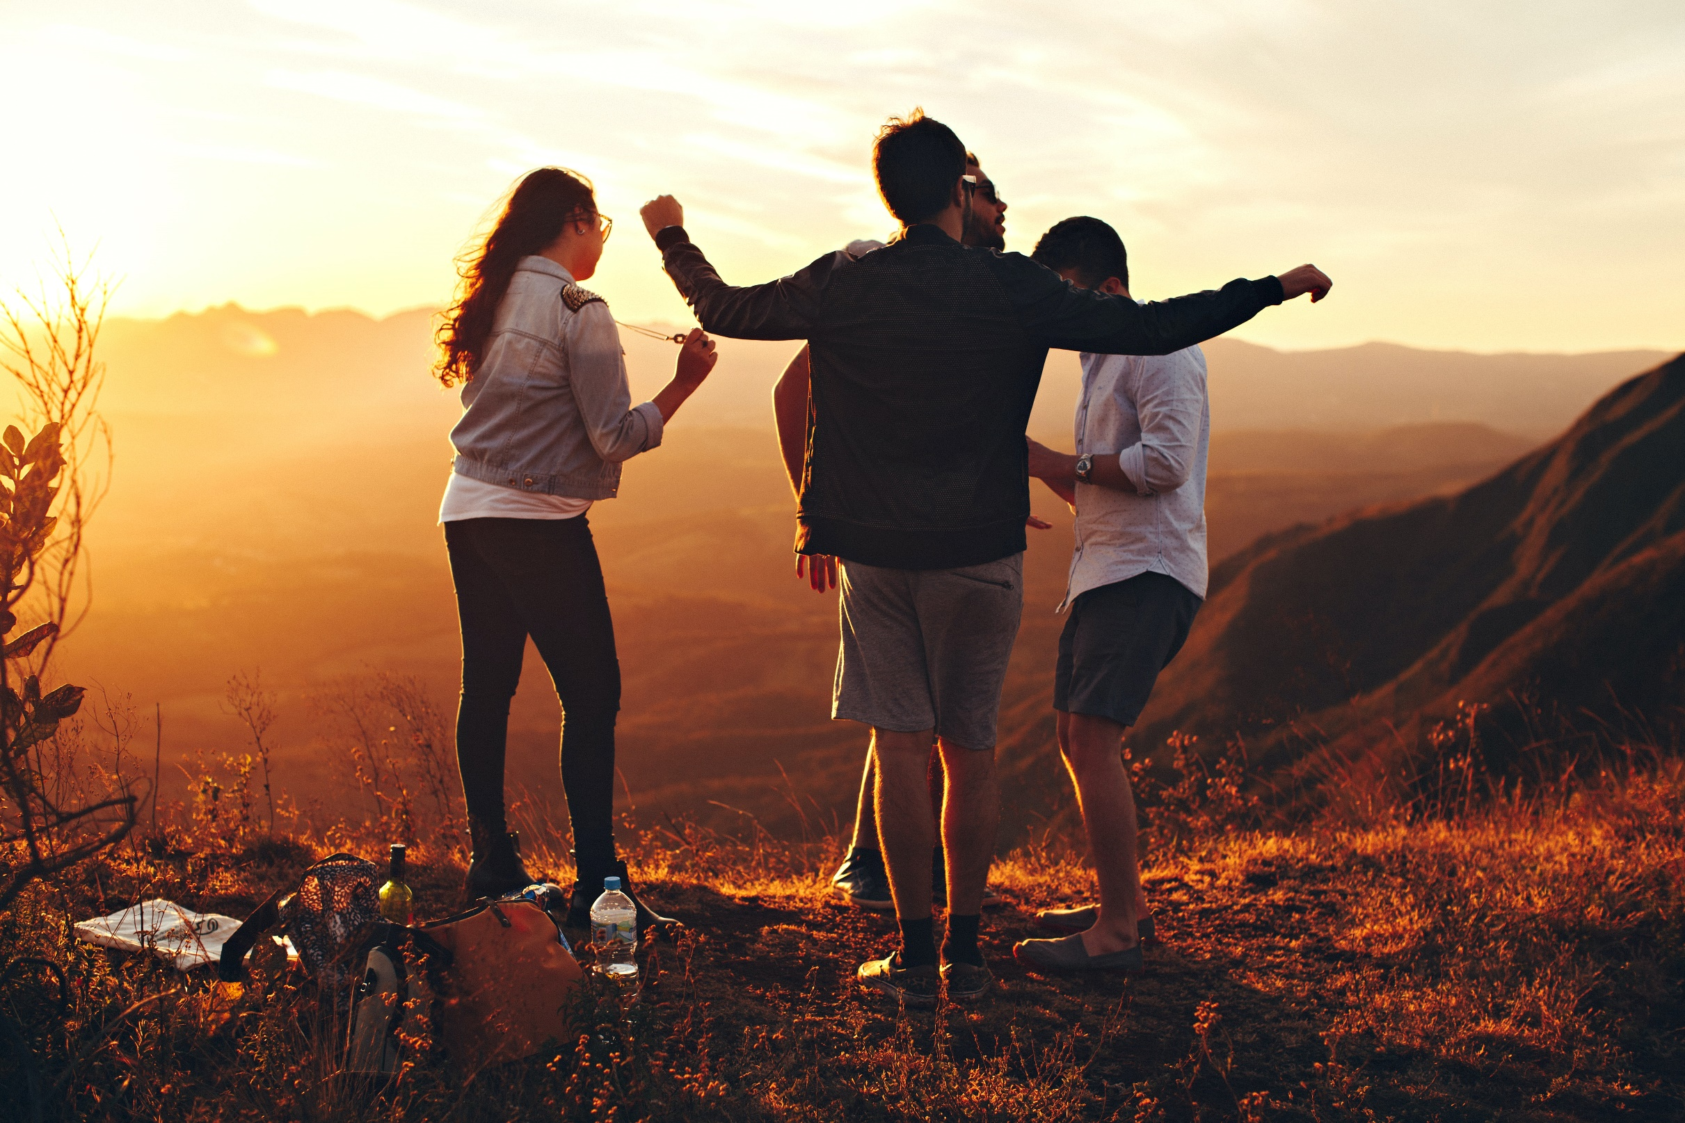

Slide 5
  Then God said, “Let Us make humankind
  in Our image, after Our likeness,
  so they may rule over the fish of the sea
  and the birds of the air

Slide 6
  over the cattle, and over all the earth,
  and over all the creatures that
  move on the earth.

Slide 7
  God created humankind in His own image,
  in the image of God He created them,
  male and female He created them.
  Genesis 1:26-27 NET

Slide 8
  It is not good for the ‘adam’ to be alone.
  I will make a companion for him who
  corresponds to him. Genesis 2:18

Slide 9
No one climbs alone!

Slide 10
  We were meant to be known
  and loved by God.
  We were meant to be known
  and loved by others.

Slide 11
  Where do I need to recommit
  to my relationships?

Slide 12


  Join a Southside Group today!
  southsidechurchva.org/groups

Slide 13


